Slide 1
Second Workshop on Software Challenges to Exascale Computing (13th , 14th December 2018, New Delhi) A presentation on
A review of dimensionality reduction in
high-dimensional data using multi-core and
many-core architecture
by
Mr. Siddheshwar Vilas Patil
Ph. D. Research Scholar (QIP, AICTE Scheme)
Under the Guidance of
Prof. Dr. D. B. Kulkarni
Registrar & Professor in Information Technology,
Walchand College of Engineering, Sangli, MH, India
(A Government Aided Autonomous Institute)

Slide 2
Outline
Introduction
Dimensionality Reduction
Literature Review
Challenges
Parallel Computing Approaches
Conclusion
References

Slide 3
Introduction
Massive amounts of high dimensional data
Big Data - Exponential growth and availability of data, 3Vs
Afterwards, this list was extended with “Big Dimensionality” in Big Data .
“Curse of Big Dimensionality”, is boosted by the explosion of features ( thousand or even millions of features)
Early, Data scientists - huge number of instances, while paying less attention to the features aspect.

Slide 4
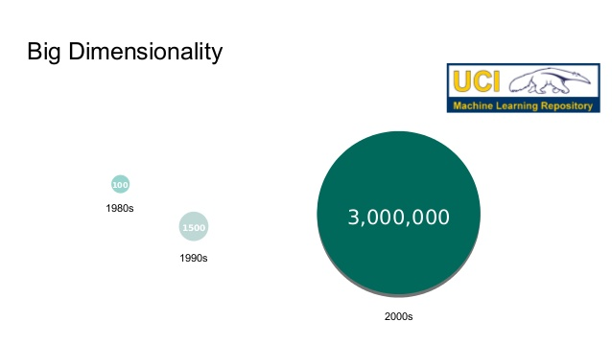
Big Dimensionality
Millions of Dimensions

Slide 5
Example- libSVM Database
In 1990s, the maximum dimensionality -62,000
In 2000s - 16 million
In 2010s - 29 million
In this new scenario, it is common now to deal with millions of features, so the existing learning methods need to be adapted.

Slide 6
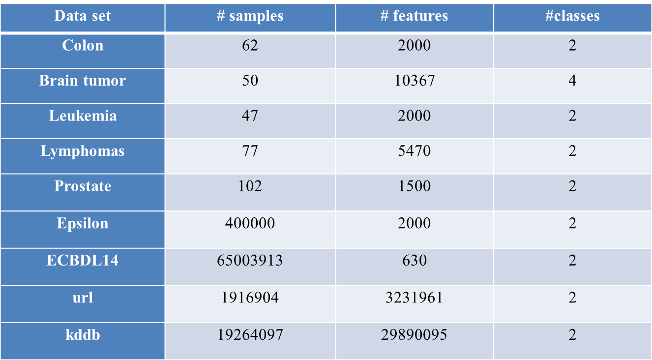
Summary of high-dimensional datasets

Slide 7
Scalability
Scalability is defined as the effect that an increase in the size of the training set has on the computational performance of an algorithm: accuracy, training time and allocated memory.

Slide 8
Methods to perform DR
Missing Values
Low Variance- Let’s think of a scenario where we have a constant variable (all observations have the same value) in data set
Not improve the power of model because it has zero variance
High Correlation- It is not good to have multiple variables of similar information.
Pearson correlation matrix to identify the variables with high correlation.

Slide 9
Dimensionality Reduction
Feature Extraction: Transforms original features to a set of new features
More compact and of stronger discriminating power.
Applications - Image analysis, Signal processing, and Information retrieval

Slide 10
Dimensionality Reduction
Feature Selection: remove the irrelevant and redundant features
Two features are redundant to each other if their values are completely correlated
Irrelevant: contain no information that is useful for the data mining task at hand
Feature is relevant if it contains some information about the target (removal of this feature will decrease accuracy of classifier)

Slide 11
Dimensionality reduction
Linear Methods:
Principal Component Analysis (PCA)
Linear Discriminate Analysis (LDA)
Multidimensional Scaling (MDS)
Non-negative Matrix Factorization(NMF)
Lasso
Non-Linear Methods:
Locally Linear Embedding (LLE)
Isometric Feature Mapping (Isomap)
Hilbert Schmidt Independence Criterion(HSIC)
Minimum Redundancy Maximum Relevancy (mRMR)
Autoencoders (Linear as well Non Linear)

Slide 12
Feature selection methods
Individual evaluation is also known as feature ranking and assesses individual features by assigning them weights according to their degrees of relevance.
Subset evaluation produces candidate feature subsets based on a certain search strategy.
Compared with the previous best one with respect to this measure.
While the individual evaluation is incapable of removing redundant features because redundant features are likely to have similar rankings, the subset evaluation approach can handle feature redundancy with feature relevance.

Slide 13
Feature Selection Steps
Feature selection is an optimization problem.
Step 1: Search the space of possible feature subsets.
Step 2: Pick the subset that is optimal or near-optimal with respect to some criterion

Slide 14
Feature Selection Steps (Cont’d)
Search strategies
–Exhaustive
–Heuristic
Evaluation Criterion
- Filter methods
- Wrapper methods

Slide 15
Search Strategies
Assuming d features, an exhaustive search would require:
Examining all possible subsets of size m.
Selecting the subset that performs the best according to the criterion.
Exhaustive search is usually impractical.
In practice, heuristics are used to speed-up search

Slide 16
Evaluation Strategies
Filter Methods
– Evaluation is independent of the classification method
– The criterion evaluates feature subsets based on their class discrimination ability (feature relevance):
Mutual information or correlation between the feature values and the class labels

Slide 17
Evaluation Strategies
Wrapper Methods
–Evaluation uses criteria related to the classification algorithm.
–To compute the objective function, a classifier is built for each tested feature subset and its generalization accuracy is estimated (e.g. cross-validation)

Slide 18
Evaluation Strategies
Evaluation Strategies
Filter based
Chi-Squared
Information Gain
Correlation-Based Feature Selection, CFS
Wrapper methods
recursive feature elimination
sequential feature selection algorithms
genetic algorithms

Slide 19
Feature Ranking
Evaluate all d features individually using the criterion
Select the top m features from this list.
Sequential forward selection (SFS) (heuristic search)
First, the best single feature is selected
Then, pairs of features are formed using one of the remaining features and this best feature, and the best pair is selected.
Next, triplets of features are formed using one of the remaining features and these two best features, and the best triplet is selected.
This procedure continues until a predefined number of features are selected.
Wrapper methods (e.g. decision trees, linear classifiers) or Filter methods (e.g. mRMR) could be used
Sequential backward selection (SBS)

Slide 20
Advantages of Dimensionality Reduction
Helps in data compression, and hence reduced storage space.
It reduces computation time.
It remove redundant irrelevant features, if any
Improves accuracy of Classification

Slide 21
Literature Review
Implementation of the Principal Component Analysis onto High-Performance Computer Facilities for Hyperspectral Dimensionality Reduction: Results and Comparisons
An Information Theory-Based Feature Selection Framework for Big Data Under Apache Spark
Ultra High-Dimensional Nonlinear Feature Selection for Big Biological Data

Slide 22
Author | Dimensionality reduction algorithm | Parallel programming model | H/W configuration | Datasets
M. Yamada et al. [7] | Hilbert-schmidt independence criterion lasso with least angle regression | MapReduce framework (Hadoop and apache spark) | Intel xeon 2.4 GHz, 24 GB RAM (16 cores) | P53, Enzyme
Z. Wu et al.[12] | Principal component analysis | MapReduce framework (Hadoop and apache spark), MPI Cluster | Cloud computing (Intel Xeon E5630 CPUs(8 cores) 2.53 GHz, 5GB RAM, 292 GB SAS HDD), 8 slave(Intel Xeon E7-4807 CPUs (12 cores) 1.86 GHz) | AVIRIS cuprite hyperspectral datasets
S. Ramirez- Gallego et al.[2] | Minimum redundancy maximum relevance (mRMR) | MapReduce on apache spark, CUDA on GPGPU | Cluster (18 computing nodes, 1 master node) computing nodes: Intel Xeon E5-2620, 6 cores/processor, 64 GB RAM | Epsilon, URL, Kddb

Slide 23
Author | Dimensionality reduction algorithm | Parallel programming model | H/W configuration | Datasets
E. Martel et al. [4] | Principal component analysis | CUDA on GPGPU | Intel core i7-4790, NVIDIA 32 GB Memory, GeForce GTX 680 GPU | Hyperspectral data
J. Zubova et al. [13] | Random projection | MPI Cluster | - | URL, Kddb
L. Zhao et al. [5] | Distributed subtractive clustering | Cluster platforms | - | Economic data (China)
S. Cuomo et al.[8] | Singular value Decomposition | CUDA on GPGPU | Intel core i7, 8GB RAM, 2.8 GHz, GPU NVIDIA Quadro K5000, 1536 CUDA cores | -
W. Li et al. [9] | Isometric mapping (ISOMAP) | CUDA on GPGPU | Intel core i7-4790, 3.6 GHz, 8 cores, 32GB RAM, GPU Nvidia GTX 1080, 2560 CUDA cores, 8GB RAM | HIS datasets -Indian pines,Salinas, Pavia

Slide 24
Challenges
Exponential growth in the dimensionality and sample size.
So, the existing algorithms not always respond in an adequate same way when deal with this new extremely high dimensions.

Slide 25
Challenges
Reducing data complexity is therefore crucial for data analysis tasks, knowledge inference using machine learning (ML) algorithms, and data visualization
Ex. Use of feature selection in analyzing DNA microarrays, where there are many thousands of features, and a few tens to hundreds of samples

Slide 26
Challenges
The time and space cost of learning feature selection/classification algorithms is large and grows fast as the variables increase.
Large amounts of data are needed for its independence test which makes the problem harder.
Classification of the high-dimensional data is challenging due to the curse of dimensionality, heavy computational burden and decreasing precision of algorithms

Slide 27
Challenges
Feature selection methods –
full search of the feature space,
testing subsets of features
evaluating them to find the final solution. The search space consists of the combination of all possible subsets, which for a dataset with n features produces a feature space of size 2^{n}.
For problems with a large number of features, finding an optimal subset of features is usually intractable (NP-hard)

Slide 28
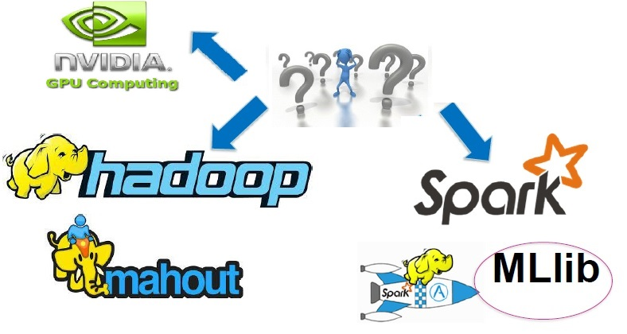
Computing approaches
Distributed implementation
Shared memory implementation

Slide 29
Scaling up FS
Distributed Feature Selection
Allocating the learning process among several workstations
Advantages:
– Reduction in execution time
– Resources sharing
– Better performance
Use of GPGPU

Slide 30
GPGPU Computing and MapReduce
GPGPUs are shared memory model and MapReduce is distributed computing frameworks aim at different scaling purposes.
Scalability approaches include vertical and horizontal scaling.
Vertical scaling: increasing the processing power, memory, and resources of a single node in a system (GPGPUs )
Horizontal scaling: adds nodes to a system and distributes the workload across them (Hadoop and Spark MapReduce frameworks)

Slide 31
Drawbacks of MapReduce
Not well suited for iterative algorithms due to performance impact of the launch overhead.
The creation of the jobs, data transfers, and nodes synchronization through the network impose an overhead
Jobs run in isolation which increases the difficulty of implementing shared communication between intermediate processes.
it requires a fault tolerant distributed file system, such as the Hadoop distributed file system (HDFS).

Slide 32
Advantage of GPGPU
Parallel algorithms running on GPGPUs- achieve up to 100X speedup over similar CPU algorithms
Very small kernel launch overhead, which permits executing parallel tasks with no delay and obtain almost instant results.
Scalability to big data is limited due to the GPU memory capacity. Multi-GPU and distributed-GPU solutions combine hardware resources to scale-out to bigger data.

Slide 33
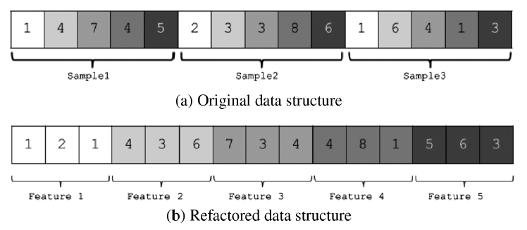
Optimizations: Data-access pattern

Slide 34
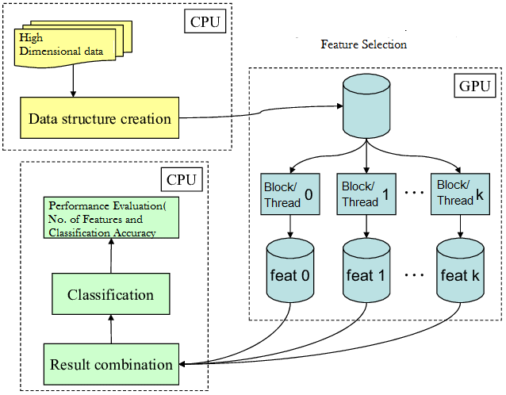
General Architecture

Slide 35
Conclusion
Need to focus on important issues of high dimensionality problems and dimensionality reduction model on it
High-performance computing approaches are best suitable for solving high dimensional data problems.
Parallel processing techniques and computational power of multi-core and many-core architecture accelerates the performance for solving high dimensional problems.

Slide 36
References
[1] E. Martel, R. Lazcano, J. Lopez, D. Madronal, R. Salvador, et al., “Implementation of the Principal Component Analysis onto High-Performance Computer Facilities for Hyperspectral Dimensionality Reduction: Results and Comparisons”, Remote Sens, 10, 864, 2018
[2] S. Ramirez-Gallego et al, “An Information Theory-Based Feature Selection Framework for Big Data under Apache Spark”, IEEE Transactions on Systems, Man, and Cybernetics: Systems. 48, 9, 1441-1453, 2018
[3] T. Gao and Q. Ji, “Efficient Markov Blanket Discovery and Its Application”, IEEE Transactions on Cybernetics, vol. 47, no. 5, pp. 1169-1179, May 2017.
[4] A. L. Heureux, K. Grolinger, H. F. Elyamany and M. A. M. Capretz, “Machine Learning With Big Data: Challenges and Approaches”, IEEE Access, vol. 5, pp. 7776-7797, 2017
[5] L. Zhao, Z. Chen, et al., “Distributed feature selection for efficient economic big data analysis”, IEEE Transactions on Big Data , 2018

Slide 37
References
[6] L. Kasun, Y. Yang, G. Huang and Z. Zhang, “Dimension Reduction With Extreme Learning Machine”, IEEE Transactions on Image Processing, vol. 25, no. 8, pp. 3906-3918, 2016
[7] M. Yamada et al., "Ultra High-Dimensional Nonlinear Feature Selection for Big Biological Data," in IEEE Transactions on Knowledge and Data Engineering, vol. 30, no. 7, pp. 1352-1365, 1 July 2018.
[8] Cuomo, S., Galletti, A., Marcellino et al., “On gpu-cuda as preprocessing of fuzzy-rough data reduction by means of singular value decomposition”, Soft Computing 22(5), 1525-1532 , 2018
[9] Li, W., Zhang, L., Zhang, L., Du, B., “GPU parallel implementation of isometric mapping for hyperspectral classification”, IEEE Geoscience and Remote Sensing Letters 14(9), 1532{1536 (2017)

Slide 38
References
[10] T. Mingjie, Y. Yu, W. G. Aref, Q. Malluhi and M. Ouzzani, “Efficient Parallel Skyline Query Processing for High-Dimensional Data”, IEEE Transactions on Knowledge and Data Engineering, 2018
[11] K. Passi, A. Nour and C. K. Jain, “Markov blanket: Efficient strategy for feature subset selection method for high dimensional microarray cancer datasets”, IEEE International Conference on Bioinformatics and Biomedicine (BIBM), 2017
[12] Z. Wu, Y. Li, A. Plaza, J. Li, F. Xiao and Z. Wei, “Parallel and Distributed Dimensionality Reduction of Hyperspectral Data on Cloud Computing Architectures”, IEEE Journal of Selected Topics in Applied Earth Observations and Remote Sensing, vol. 9, no. 6, pp. 2270-2278 , 2016
[13] J. Zubova, M. Liutvinavicius, O. Kurasova:, “Parallel computing for dimensionality reduction”, Communications in Computer and Information Science, vol. 639. Springer, Cham , 2016

Slide 39
Thank You.!

